Slide 1
HCAI: Vertical & Horizontal Slicing
Narrowing down how the user experiences using (aspects of) the product in their real-live environment

Slide 2
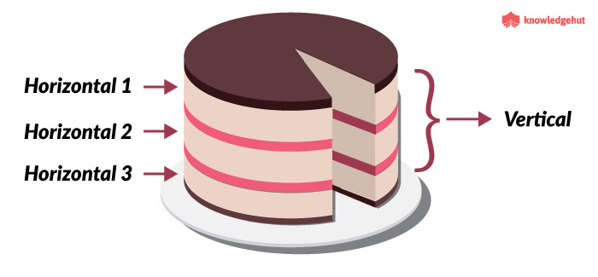
How do we build and test a product?
Building the entire product (i.e. App) and then testing it is inefficient and risks wasting a lot of time, resources etc.
What if the user doesn’t understand how to operate the app?
What if the app’s networking is unstable?
What if adding new data to train your model is buggy?
What if the user can’t provide feedback to label data?
Etc.
That’s why we do prototyping, and specifically we will prototype certain aspects of a product like an app, game or program that we’re building. Prototyping select aspect is often referred to as serving a potential user specific pieces of the whole pie:
Therefore: vertical and horizontal slicing!

Slide 3
What do we want to gain?
User-Experience insights
How the user experiences using the product in his real-live environment
What does the user actually do with your CV algorithm and how does he experiences it?
Does it solve the problem? How well does it do that?
How can we iterate based on these insights?
Depends on
What do we want to test?
How we test and measure it; which user tests and variables?
You should determine that before building your slice, but we’ll get to that...
Let’s explore the types of slices we can serve the user first

Slide 4
Types of vertical and horizontal slices
Design
User needs are converted into Features:
Conceptual workout of how the product is going to solve that need (e.g. Which beer to buy; beer recommender)
Granularity:
High-level design (e.g. The CV algorithms will identify beers)
Low-level design (e.g. A CNN will classify a beer label to identify a beer)
Product: Result of the Design
User-Interface/Front-end
Topic/Domain Logic
Database/Back-end
Features (e.g. Your CV model)

Slide 5
Full Prototype
Complete: concerns all aspects of the project in a basic level
Full-Project Architecture: Everything is designed (and build) on the lowest level
User Interface
Topic/Domain
Database/Back-end
Features
E.g. A command line interface, an alpha game

Slide 6
Horizontal Slice Prototype
Concerns all aspects of the project for a given layer on the most basic level
User Interface
Topic/Domain
Database/Back-end
Features
Horizontal Slice: High-Level design/application with the most basic application functionality for a given slice
E.g. Building (all) your PoC model(s) in a Juypter notebook

Slide 7
Horizontal Slice Prototype
Concerns all aspects of the project for a given layer
Horizontal Slice: High-Level design/application with the most basic application functionality for a given slice
User Interface
Topic/Domain
Database/Back-end
Features
E.g. Your wireframe prototype

Slide 8
Vertical Slice Prototype
Concerns all aspects of the project for a single feature
(Computer Vision Model) Feature Fully Designed/Build on the lowest-level; and fully functionally
User Interface
Topic/Domain
Database/Back-end
Features
E.g. app which can only demonstrate 1 feature (gold)

Slide 9
Vertical Slice Prototype:
Concerns all aspects of the project for a single feature, and focusses on smaller aspects to test & gain insight quicker
Vertical Slice of Design: User Interface completely designed → Low-level design paper shaped into a paper prototype
User Interface
Topic/Domain
Database/Back-end
Features
Vertical Slice of Design: Computer Vision Feature completely designed → Low-level design shaped into a Wizzard of Oz Experiment
E.g. Wizzard of Oz – Paper Prototype: Datalab

Slide 10
Any questions?
Feel free to ask in the Q&A channel!

